Slide 1


ML and DL applied for Autonomous Vehicles
PyData Global Impact Community Get-Together
Applied Projects and Development
Marcelo Fernando Condori Mendoza
marcelof.condor@gmail.com
LinkedIn: https://www.linkedin.com/in/marcelo-fernando-condori-mendoza-46131645/

Slide 2

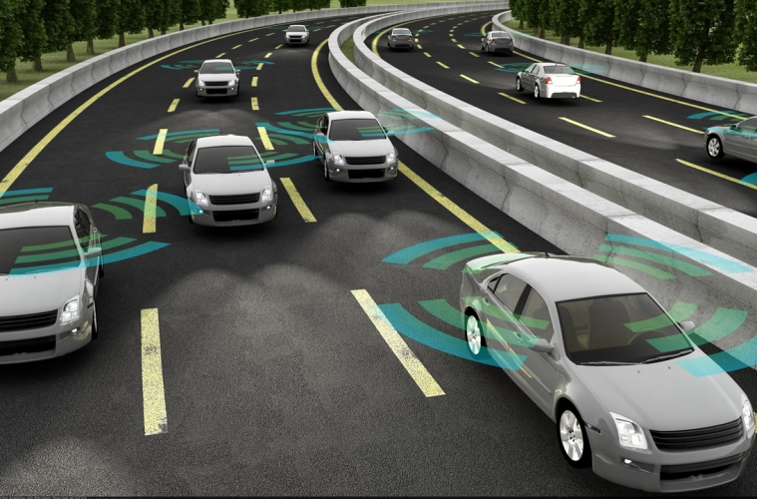
Background
Autonomous Driving has become one of the most popular research points in the field of artificial intelligence (AI). In the case of autonomous vehicles, it is based on reinforcement learning algorithms and heuristic planning. The proposed decision engine focuses on keeping autonomous vehicles running safely and efficiently.

Slide 3

Objectives
Implement a prototype that allows demonstrating driving in autonomous cars using the Carla Simulation tool in addition to demonstrating with a physical prototype the operation of some sensors that are applied in autonomous cars.
General
Secondary
Investigate the technology implemented in autonomous cars.
Analyze and understand the tool to be used for the simulation.
Install the tool and configure for simulation.
Test the respective system.

Slide 4
Design an autonomous system based on the principles and fundamentals of mobile robotics, whose functionality, under the acquisition of a signal, determines its physical behavior, moving freely in an environment
Secondary Objetives
Implement a physical structure of a mobile robot as an autonomous system, together with the systems that compose it, such as the movement system, the control system and the sensory system.

Slide 5

Software Tools

Slide 6
01
Carla Simulator
03
Docker
02
Unreal Engine
04
Arduino

Slide 7
APPLIED DEVELOPMENT

Slide 8
Execution and Testing Carla Simulator in Ubuntu Operative System

Slide 9
Testing and Downloading Different Versions
0.7.1
0.9.0
0.6.0
0.8.3
0.9.9.4

Slide 10
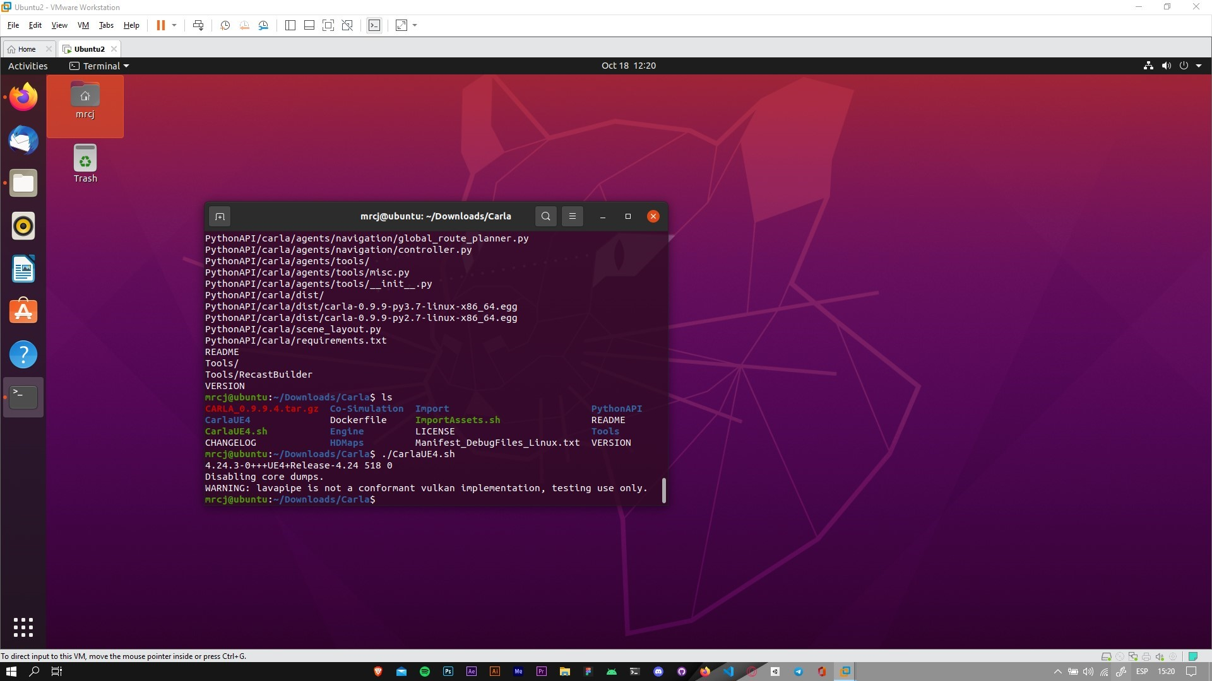
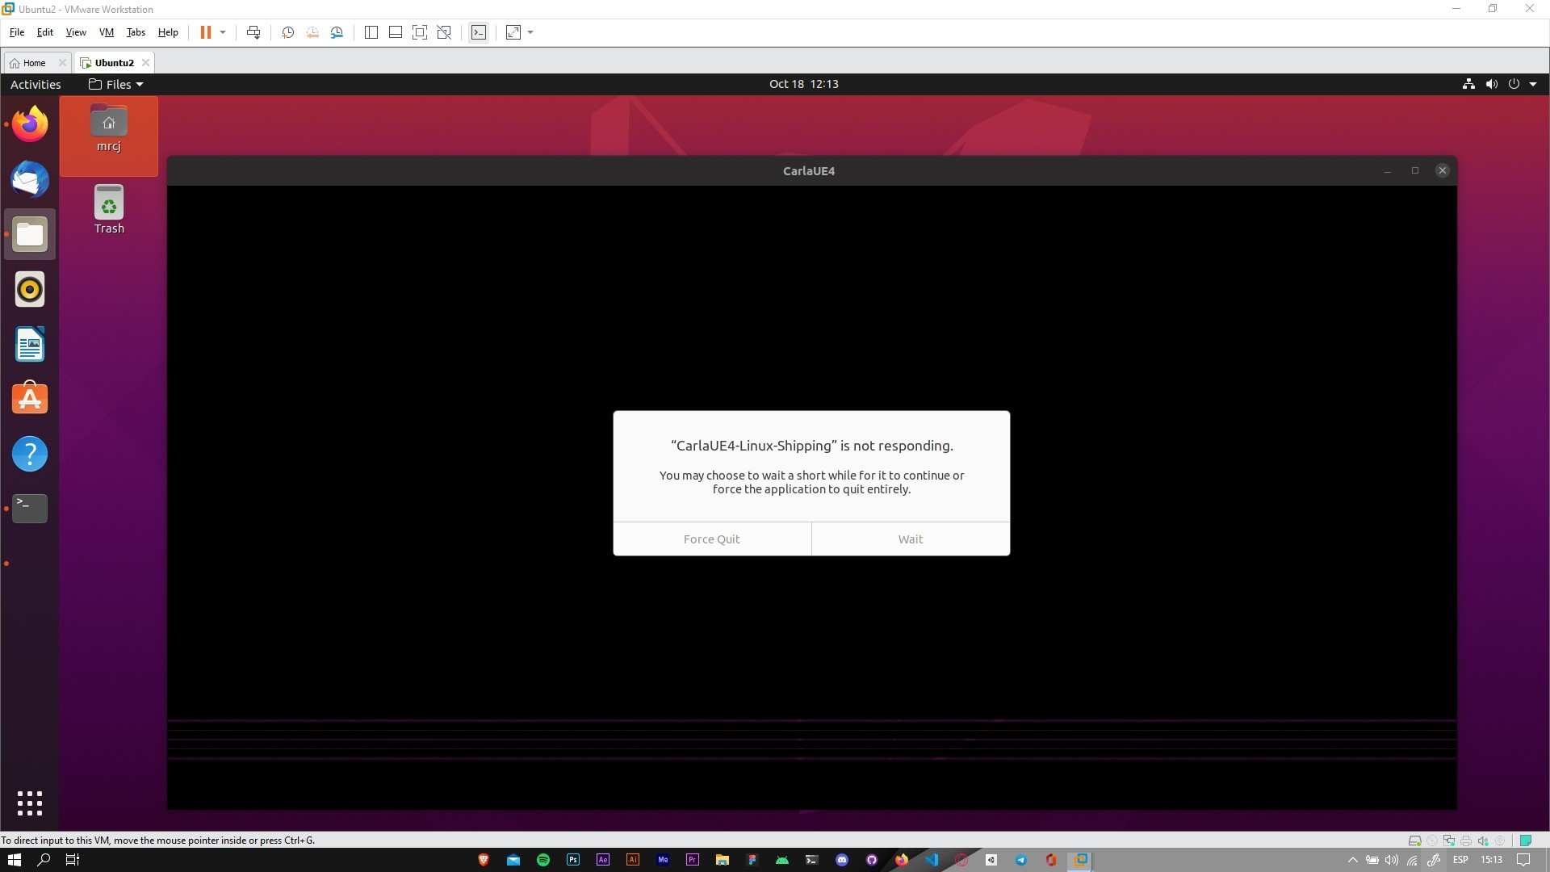
Executing Carla 0.9.9.4
Visualizing the Trial of Carla 0.9.9.4

Slide 11
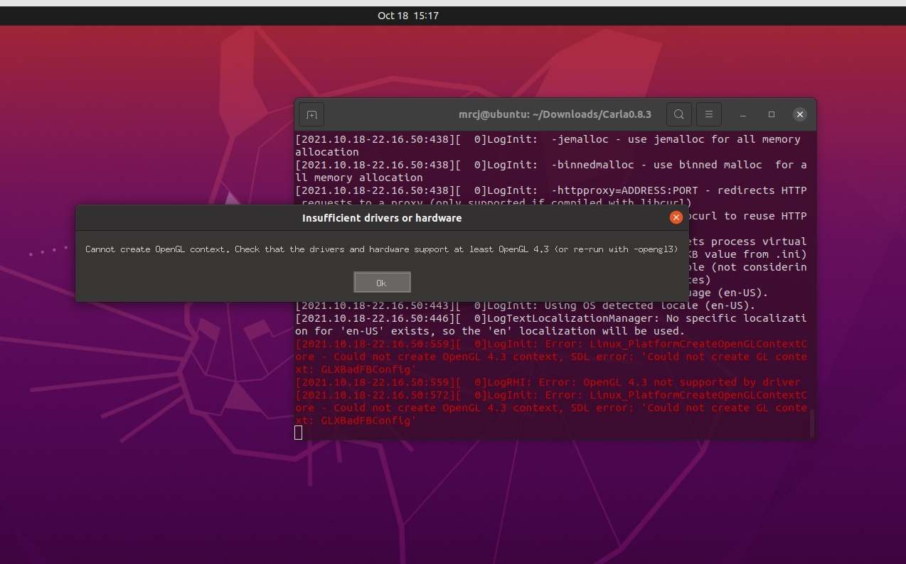
Executing Carla 0.6.0 - 0.8.3
Associated bug on OpenGL due to old graphics card version, element which helps 3D rendering.

Slide 12
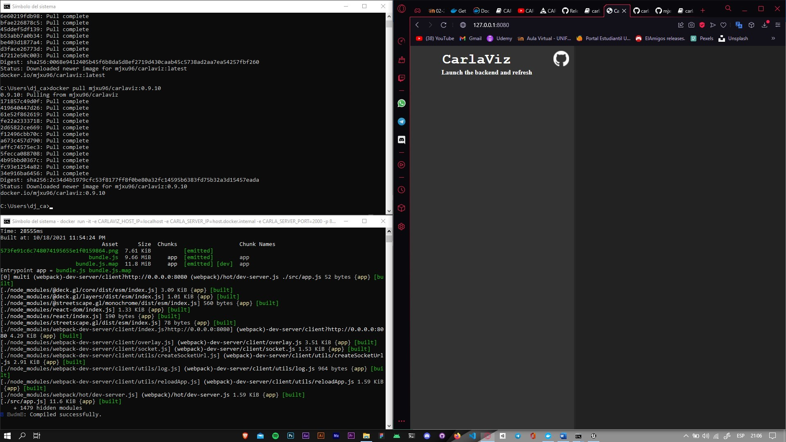
Simulation Test using Docker Tool
Carla Simulator database execution problem

Slide 13
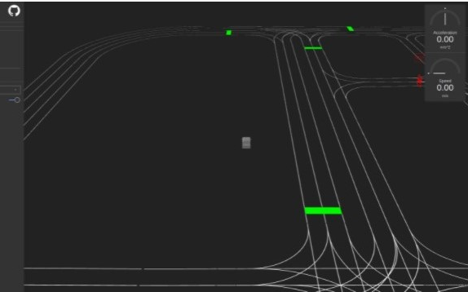
Expected Result Using Docker
This option uses CarlaViz which is a plugin which allows the simulation to be viewed in a web browser. Next, it performs a basic representation of the scene based on lines and polylines.

Slide 14
Executing and Testing Carla Simulator in Windows Operating System

Slide 15
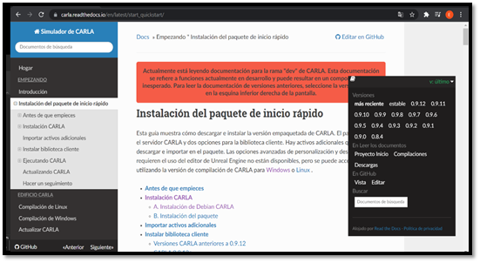

Slide 16
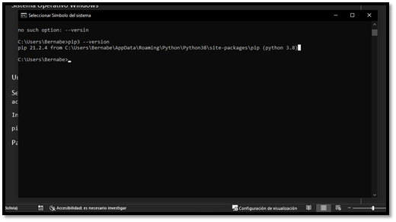

Slide 17
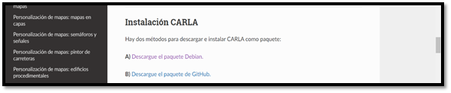

Slide 18
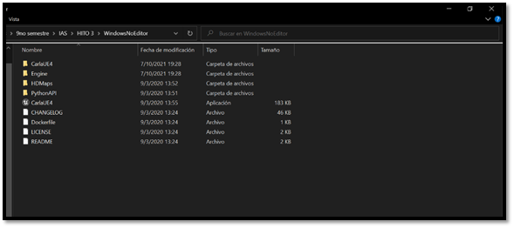

Slide 19
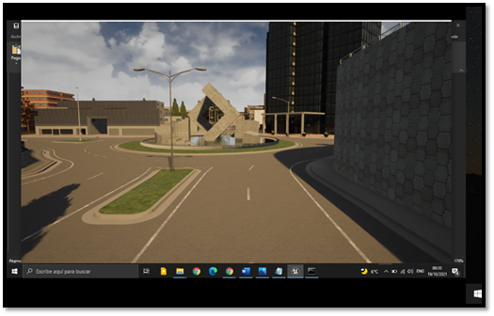

Slide 20
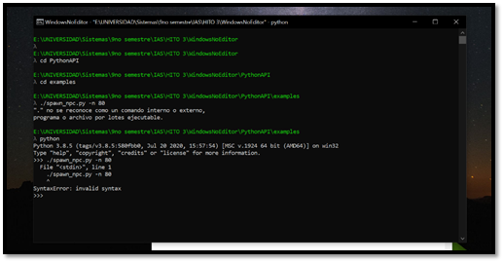

Slide 21
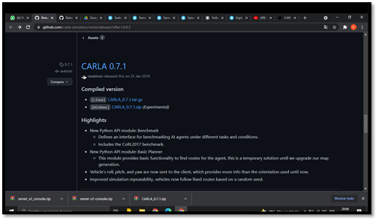

Slide 22
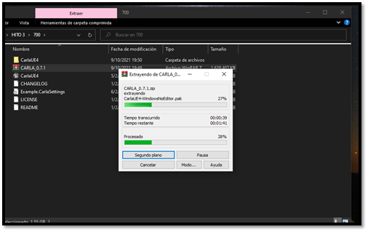

Slide 23
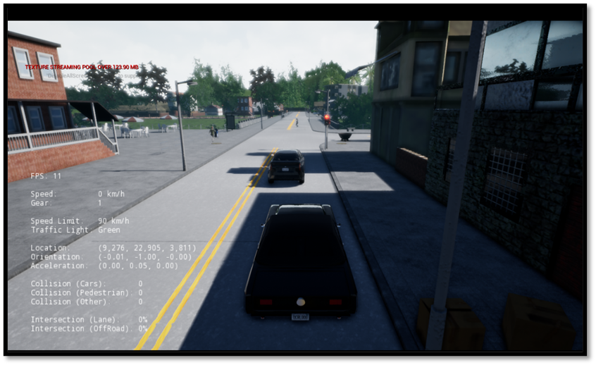
Carla Application

Slide 24
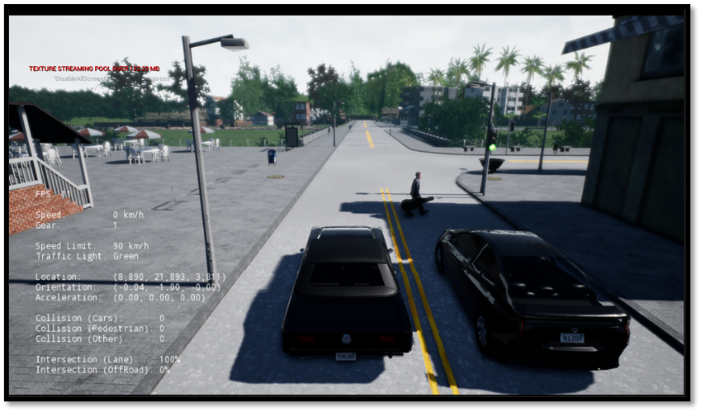
Objects Detection

Slide 25
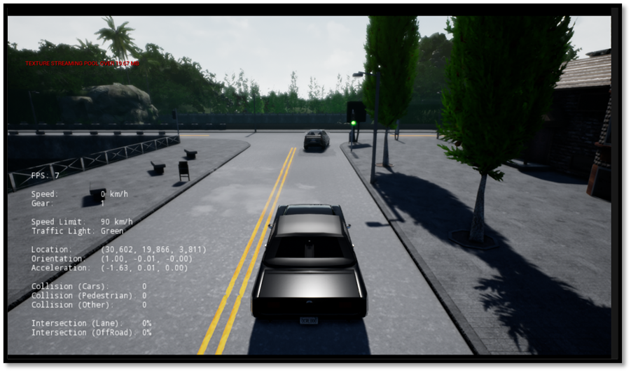
Traffic Signals Compliance

Slide 26
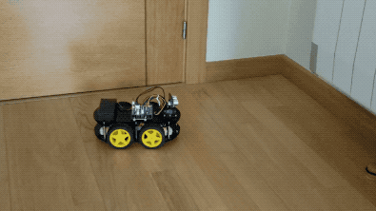
Small Auto that avoids obstacles.

Slide 27
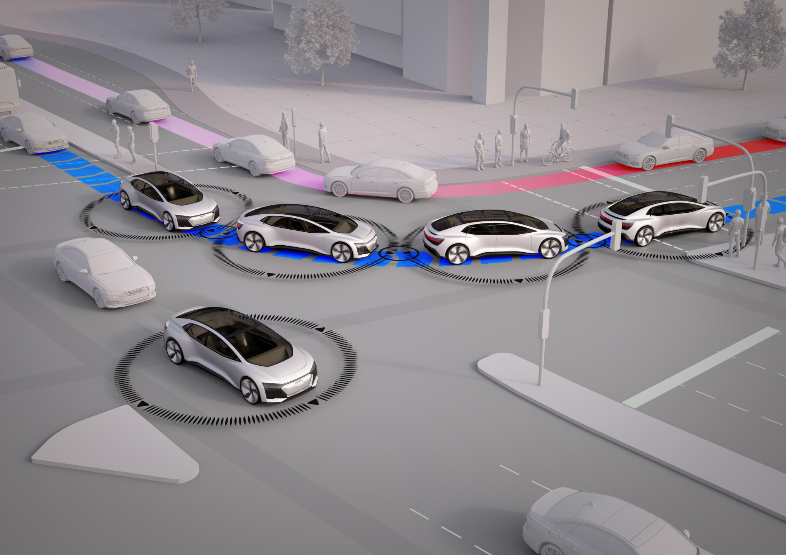
Application of the Small Auto that avoids obstacles.
Through the Avoid Obstacles function, the robot must be able to travel a circuit avoiding all the obstacles placed on the route. For this purpose, the robot will have an ultrasonic sensor HCSR04

Slide 28
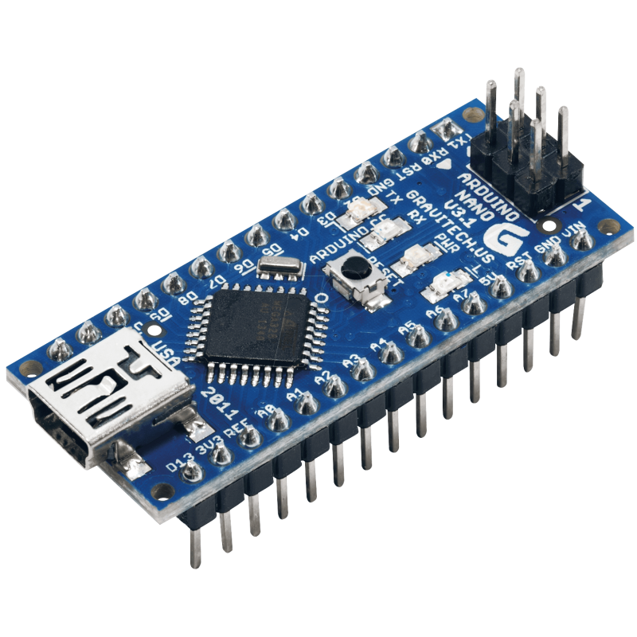
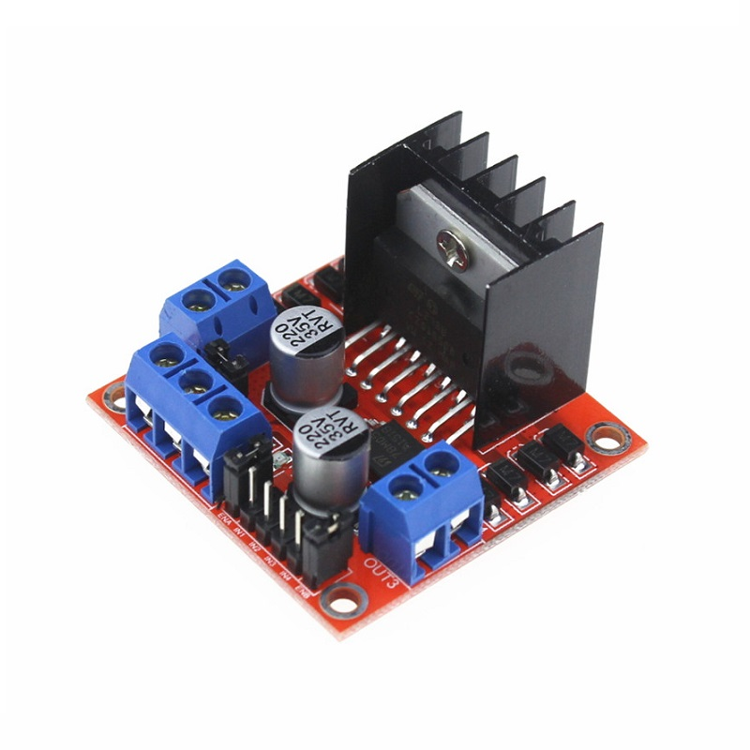
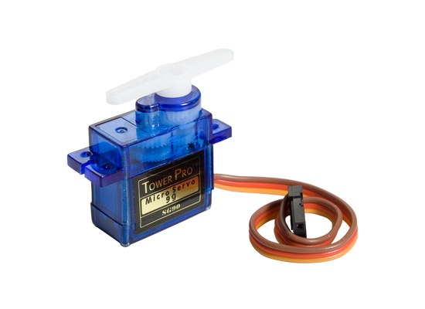
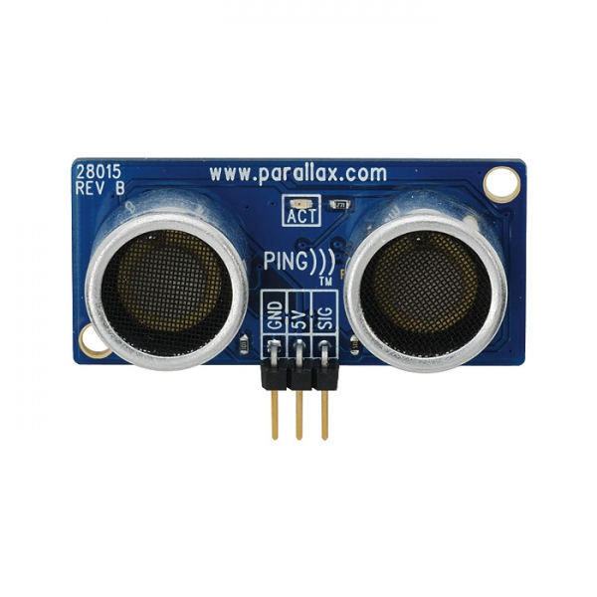
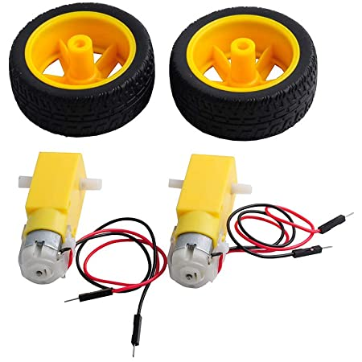
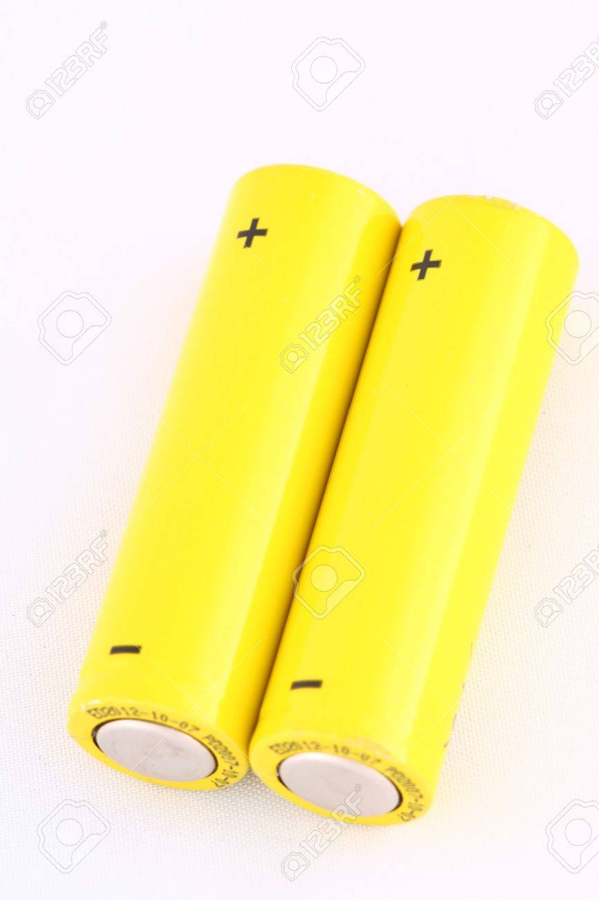
Implemented Hardware Tools

Slide 29
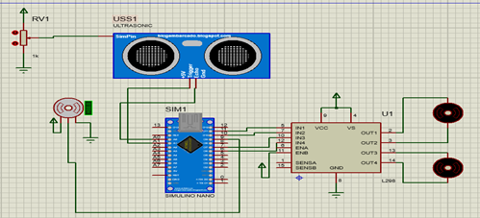
Proteus Simulation

Slide 30
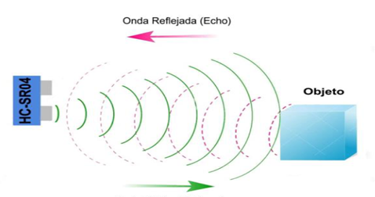
What is the Main Functioning Principle?
1. Send a pulse of approximately 10 uS through the Trigger pin
2. The sensor will send eight 40KHz pulses and set the Echo pin in HIGH. This is necessary to trigger the timer.
3. When the sensor receives the reflected pulse, it will set the Echo pin in LOW and thus end the time counting.
4. The distance can be obtained using the speed of sound (340 m/s) multiplying it by the time obtained in us x 0.017

Slide 31
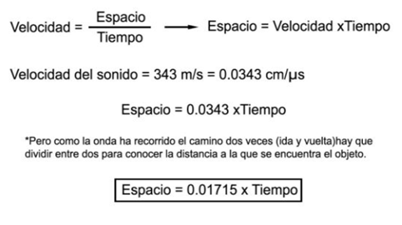
Formula for the Ultrasonic Sensor

Slide 32
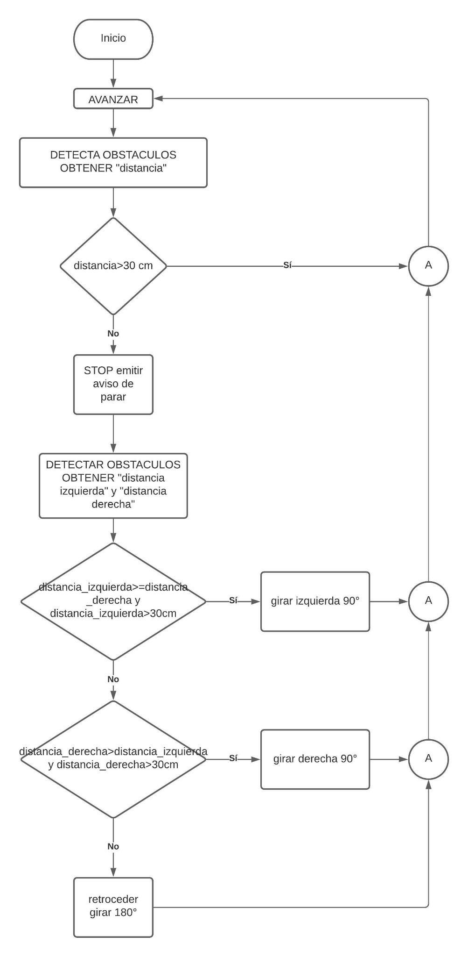
Workflow for the Robot that avoids Obstacles

Slide 33
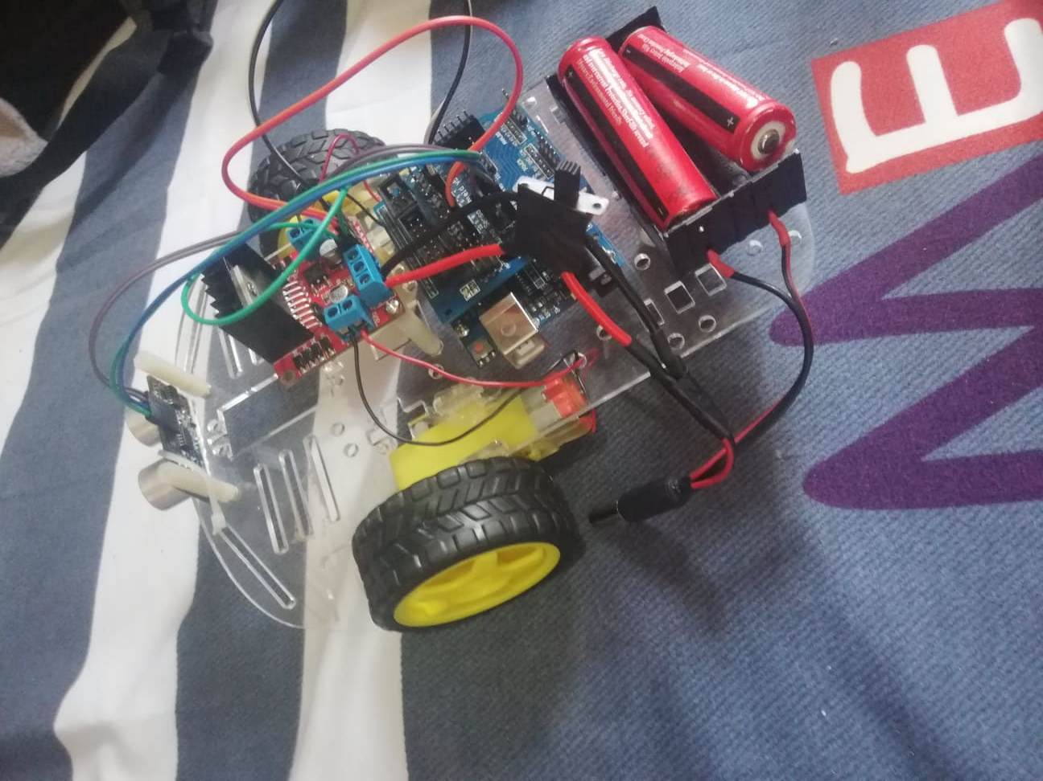
Implemented Hardware Circuitry

Slide 34
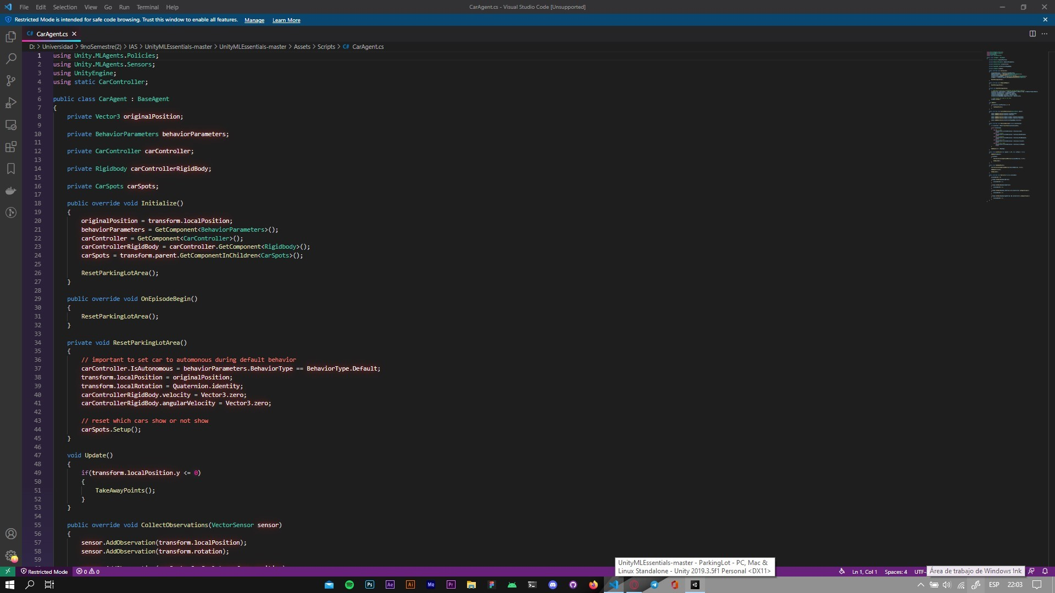
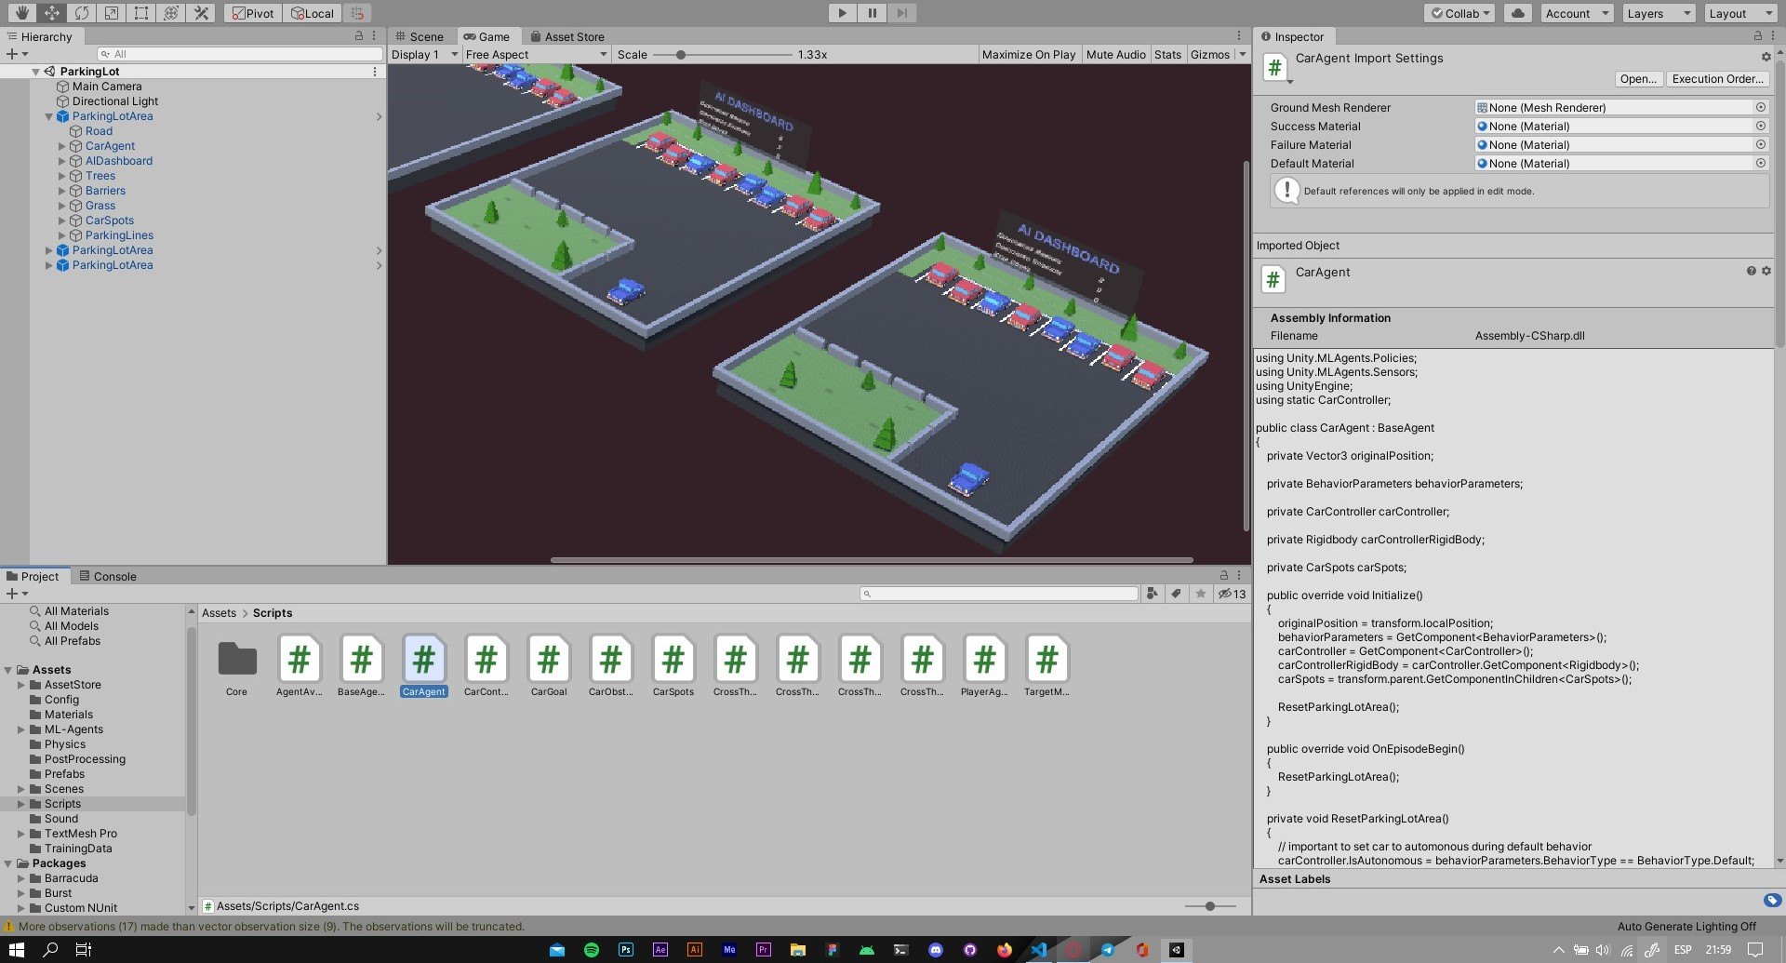
Other Applications
Intelligent Agents for Automobile Parking

Slide 35
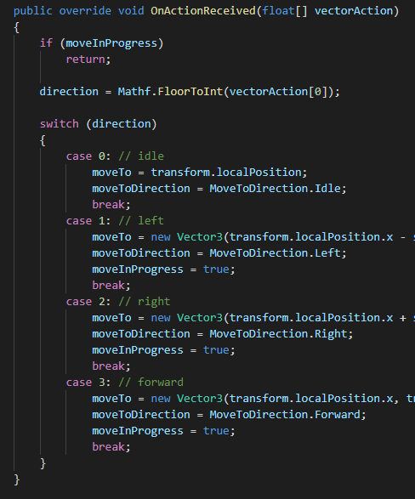
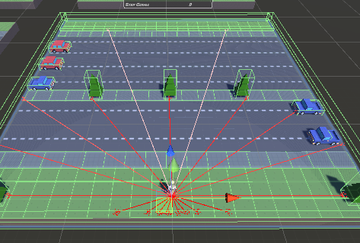
Funcionamiento
Automóviles Inteligentes

Slide 36
Based on the tests carried out on the Linux-Ubuntu system, it is observed that, due to some installation omission of some dependency, or trying to apply new versions, a lot of performance is necessary on the part of the computer for its execution, and based on Docker is considered to be a very stable solution for low to medium performance computers.
Conclusions
It was possible to install the CARLA environment for windows in its first version for the operating system, it was also possible to observe the fluid traffic that exists in carla to be able to study the movements of autonomous cars, which comply with what was proposed, such as: Autonomous cars that respect the lines of the driving lanes by not leaving their lanes, report the traffic if there are cars ahead the car stops and finally respect the rules of the traffic light if it is red it stops and if it is green it advances.

Slide 37
The implementation of mobile robots can make very viable solutions in technological developments with low costs and high benefits, referring to industrial needs, as well as with customized prototypes for autonomous cars. We can understand and simulate their operation to see how autonomous cars react in an environment that is controlled and scaled.
Conclusions

Slide 38
Thank you very much for your attention!

